Slide 1
Multilingual Ontologies for Cross-Language Information Extraction and Semantic Search
Stephen W. Liddle, Information Systems Department
David W. Embley, Computer Science Department
Deryle W. Lonsdale, Department of Linguistics and English Language
Brigham Young University, Provo, Utah, USA
Yuri Tijerino, Department of Applied Informatics
Kwansei Gakuin University, Kobe-Sanda, Japan
1 November 2011
30th International Conference on Conceptual Modeling
Brussels, Belgium

Slide 2
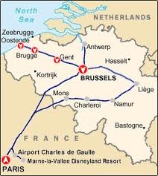
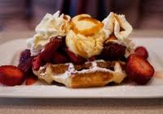
Local Knowledge Is Valuable
What is the best way to get from A to B?
Optimize time, cost, convenience
Where can I find good food at a good price?
Optimize quality, price, schedule constraints
Are there high-value deals (bargains) available for consumer products you may want?

Slide 3
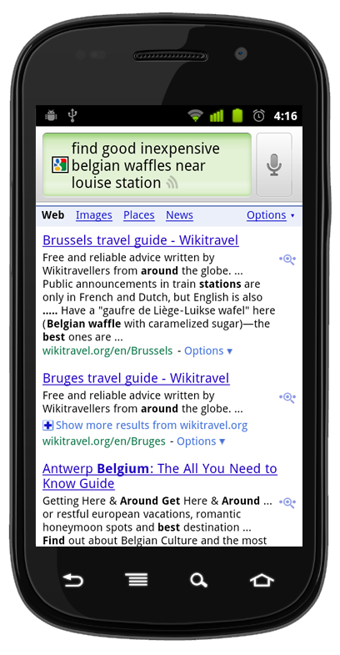
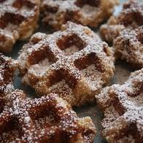
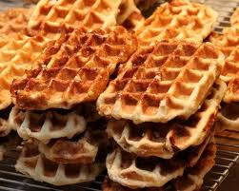
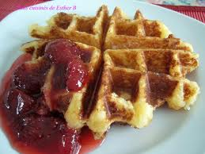
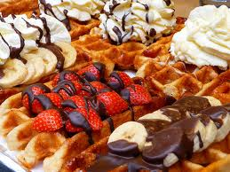
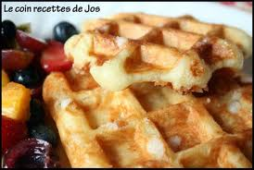
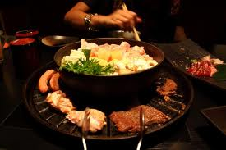
An Example
I’m visiting Osaka, Japan and I’m getting hungry
Query: “Find a BBQ restaurant near the Umeda station, with typical prices less than $40”
Potential knowledge sources
Hotel concierge
Someone at the company or university I’m visiting
Search engines

Slide 4
Google Says…
Find a BBQ restaurant near the Umeda station, with typical prices under $40
We’re getting some local knowledge, but I want more

Slide 5
Compare with Local Search
Query: “Sandwich shops near Provo, Utah”
Reviews
Location &
Contact Info
Map

Slide 6
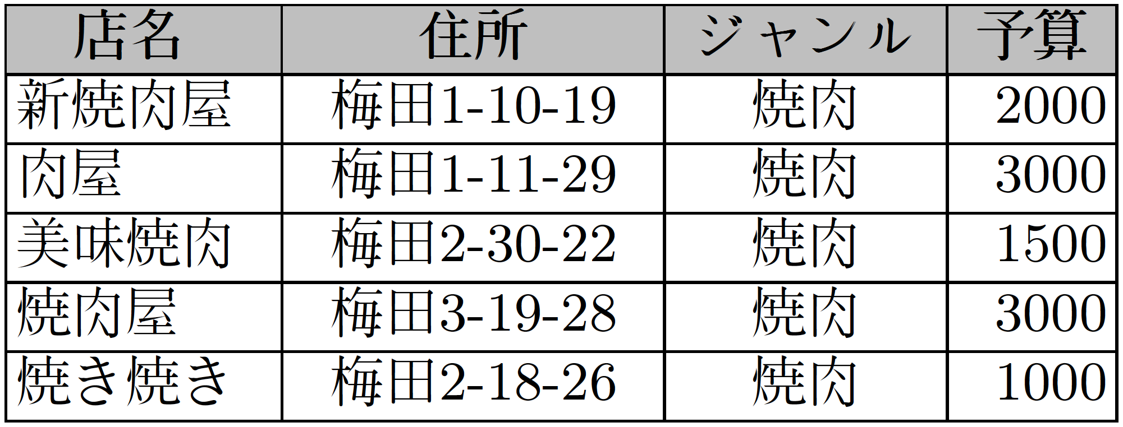
Local Knowledge Is Encoded in the Local Language
If I could query in Japanese over a structured database, I might find this:

Slide 7
A Better Scenario

Slide 8
Building Blocks
Past work:
Ontology-based data extraction system (OntoES)
Free-form query answering system (AskOntos/HyKSS)
New proposal:
MultiLingual Ontology Extraction System
(ML-OntoES)

Slide 9
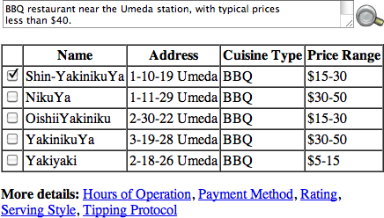
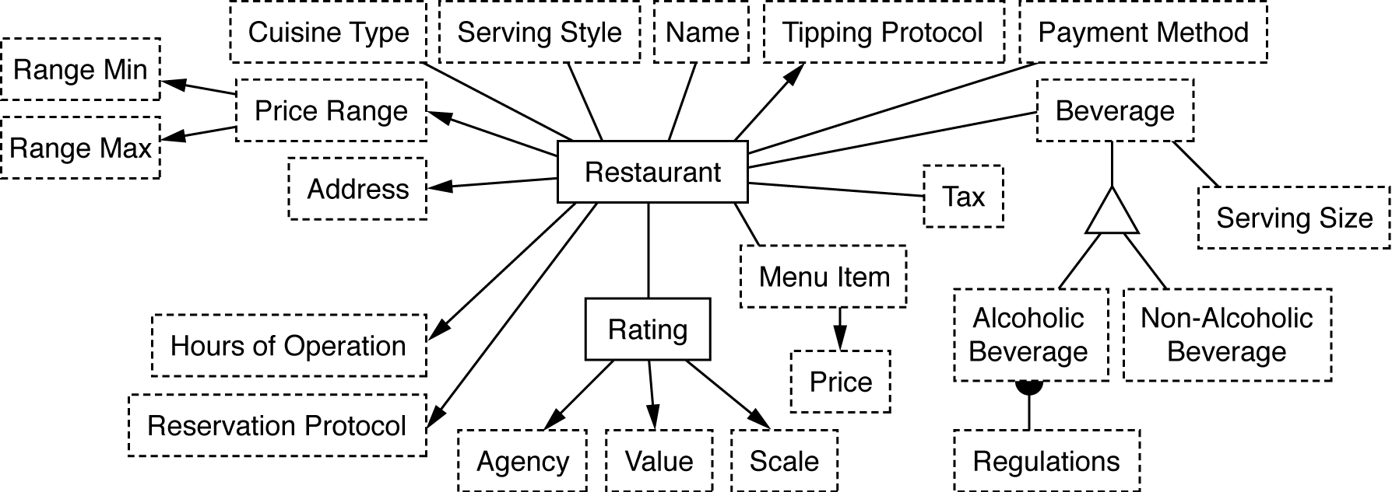
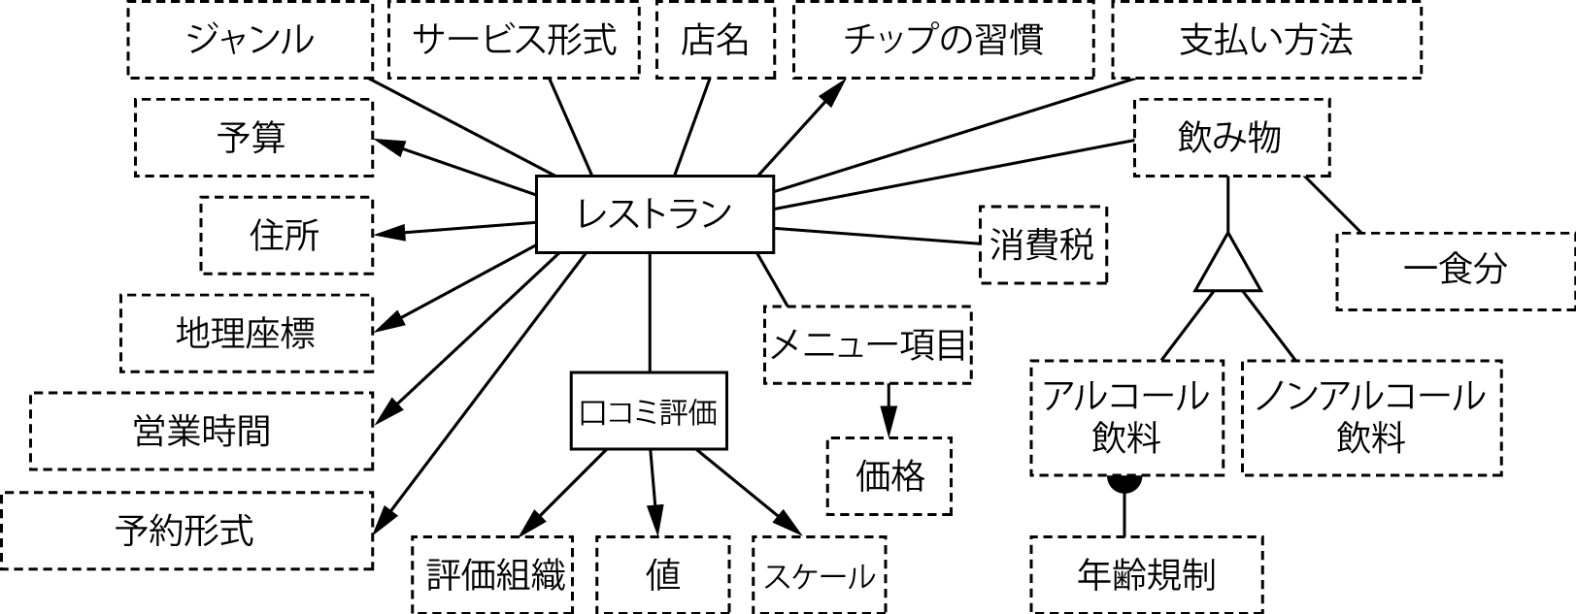
ML-OntoES Process
“Find a BBQ restaurant near the Umeda station, with typical prices under $40”
Language-Agnostic Ontology

Slide 10
Multilingual Ontology
Multilingual ontology localized to N contexts
Language-agnostic ontology (A)
N localizations, each L_{i} having:
Context label
Extraction ontology (O_{i})
Set of mappings from L_{i} to A
Set of mappings from A to L_{i}
L₁
L_{n}
A
L₂
L₅
L₃

Slide 11
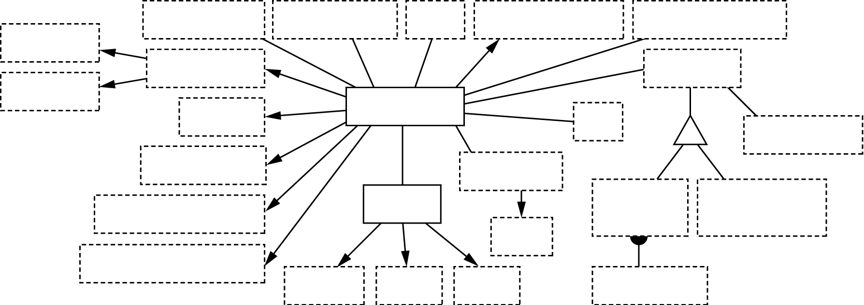
Star Architecture
L₁
L_{n}
Language-Agnostic Restaurant Ontology (A)
A
L₂
L₅
L₃
U.S. Localization (L_{en_US})
Japanese Localization (L_{jp_JP})

Slide 12
Restaurant Ontology U.S. Localization

Slide 13
Restaurant Ontology Japanese Localization

Slide 14
Ontology Construction Strategy
Start with extraction ontology in one language
Language-agnostic ontology is one-to-one with first language
For each localization:
Adjust central language-agnostic ontology as needed to accommodate concepts in the new localization
Each concept in localization must map to a single concept in the central ontology (injective from L_{i} to A)
Not all concepts in central ontology need map to each localization (surjective from A to L_{i})

Slide 15
Types of Mappings
Structural (schema) mappings
Most are direct
We also support 1:n, n:1, m:n, split, merge, select, etc.
Data instance mappings
Scalar units conversions
Lexicon matching
Transliteration
Currency conversions
Commentary mappings

Slide 16
Scalar Units Conversions

Slide 17
Lexicon Matching
English | French
meal | repas
meal (flour) | farine
supper | souper
Term base systems
Lexical databases
Statistical machine translation

Slide 18
Transliteration
Muhammar Ghadaffi
At least 39 variant spellings in English
Bill Clinton
At least 6 variants of “Clinton” in Arabic
Single language: machine learning techniques, language resources
Cross-linguistic: lexicon possible, but on-the-fly tools may be more helpful
Created via automatic Kanji-to-English transliteration tool
45

Slide 19
Currency Conversions
1 Euro = 1.40009 US Dollar
1 British Pound = 1.14534 Euro
1 Swiss Franc = 1.14846 USD
But exchange rates change over time
Solution: web services
Look up exchange rate at date/time

Slide 20
Commentary Mappings
Some ideas require commentary to describe well
Tipping protocol
How meals are structured
Dress codes
Automatic translation can help
Gives starting point
Can give something for virtually any commentary
Likely requires human refinement
n² mappings, but pay-as-you-go tuning, base level “free”

Slide 21
Automatic Translation
“Reservations highly recommended, especially on Friday, Saturday, and holiday evenings”
translate.google.com:
“Réservations fortement recommandé, surtout le vendredi, samedi, et les soirées de vacances”
babelfish.yahoo.com:
“Réservations fortement - recommandé, particulièrement vendredi, samedi, et soirées de vacances”

Slide 22
Automatic Translation
“Reservations highly recommended, especially on Friday, Saturday, and holiday evenings”
translate.google.com:
Reservierungen dringend empfohlen, vor allem am Freitag, Samstag und Feiertag abends
Reservas muy recomendable, sobre todo los viernes, sábados y las fiestas en
Reservasjoner anbefales, spesielt på fredag, lørdag og ferie kvelder
예약 매우 특히 금요일, 토요일 및 공휴일 저녁에 권장
Tempahan amat disyorkan, terutamanya pada hari Jumaat, Sabtu, dan malam hari bercuti

Slide 23
Pijin Prototype
Accept free-form natural-language queries
English, Japanese, Chinese
Map to restaurant extraction ontology
Reformulate as form queries suitable for submitting to restaurant-recommendation web services
Hotpepper, LivedoorGourmet, Tabelog, Gournavi
Process Japanese results, “mash up” with Google maps
Correctly interpreted, translated queries
Japanese: 79%
Chinese: 69%
English: 72%
Loosely: “find me a BBQ restaurant that offers coupons near
Tokyo station and my budget is under 5000 yen”

Slide 24
ML-OntoES´ Prototype
Added UTF-8 abilities to OntoES
Car-ads application domain
English and Japanese extraction ontologies
Simple structure, 1-1 schema mappings
But immediately converted, stored Japanese values in English

Slide 25
ML-OntoES´ Evaluation
Free-form Query
Interpretation
Extraction
Query Results
 | ExE | ExJ | QiE | QiJ | QrEE | QrJJ | QrEJ | QrJE
Precision | .95 | .89 | .97 | .92 | .96 | .84 | .75 | .87
Recall | .94 | .91 | .94 | .82 | .95 | .84 | .72 | .85
Harmonic-Mean F-Measures
Interesting issues: years in Japanese car ads
Model year ( and )
Shaken year ( )
Heisei years (2008 written as )
Lesson: there are many subtleties

Slide 26
Contributions
ML-OntoES
Central language-agnostic ontology, pay-as-you-go incremental design
Proof-of-concept prototypes
Cross-language information extraction and semantic search can be successful

Slide 27
Future Work
Broaden our ML-OntoES prototype implementation
Experiment with more domains
Experiment with more languages
http://www.deg.byu.edu

