Slide 1
Scanned Books: Annotator Training

Slide 2
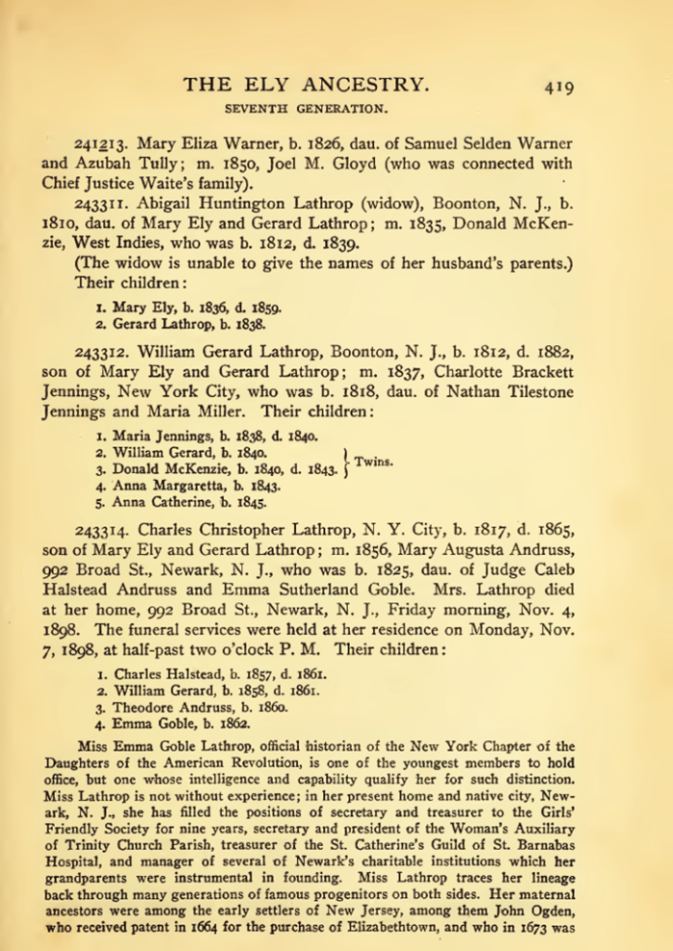
Project Overview
Untapped sources
100,000+ scanned/OCRed books
Problem: how to cost-effectively extract
Extraction tools
Read and do form-fill type-in
Form-fill by clicking
Copy/paste & correction
Genealogy construction by inference
Synergistic
Automated form-fill with user correction
Manual specification of rules (FROntIER)
Machine-learned extraction rules
Discover author-specified patterns (ListReader)
Parse sentences & match concepts (OntoSoar)
Learn from observing users work (GreenFIE-HD)
Groundtruthing
Notes:
Explain: we are “Groundtruthing” – you will be asked to extract some easily inferred information, e.g., spouses both ways, gender, same name extracted multiple times. Don’t worry about it and realize that you are helping with research of underlying extraction tools, not experimenting with expected form types for patrons.

Slide 3
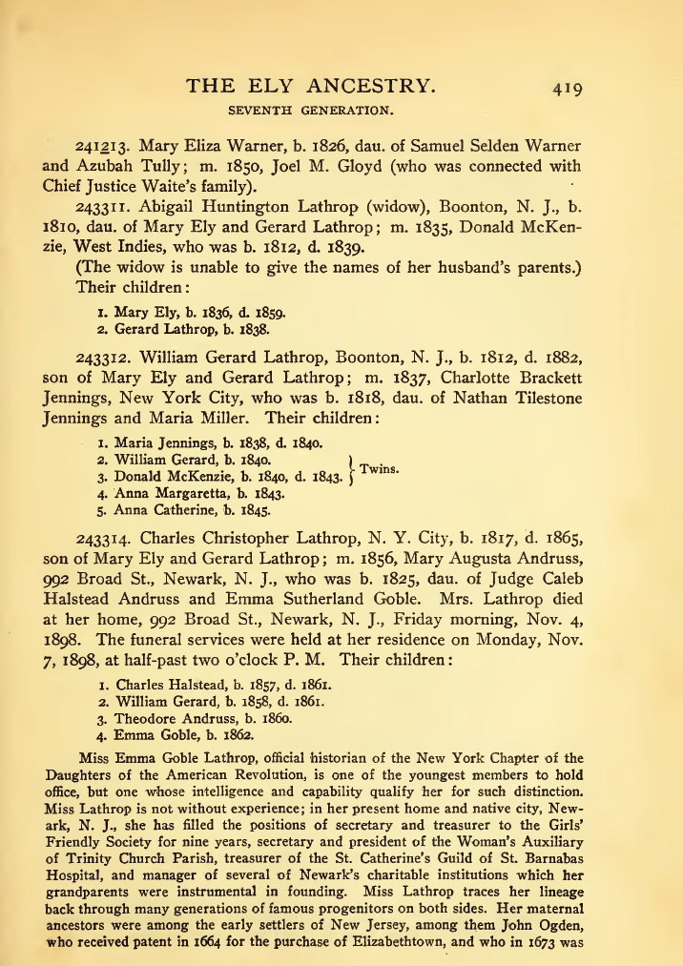

Slide 4
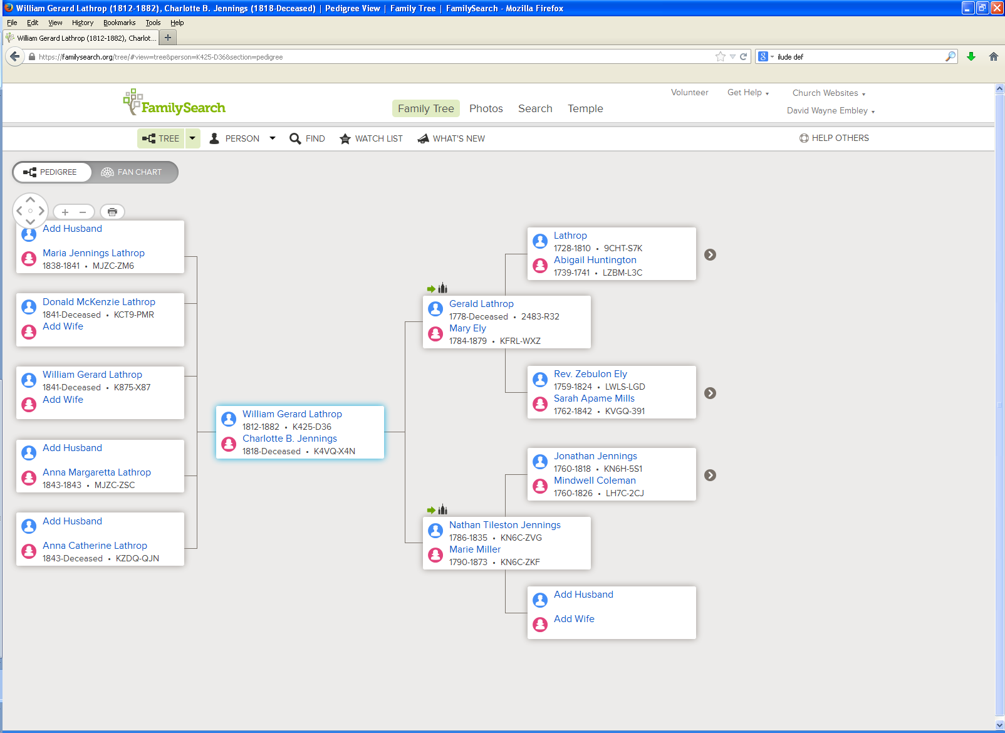

Slide 5
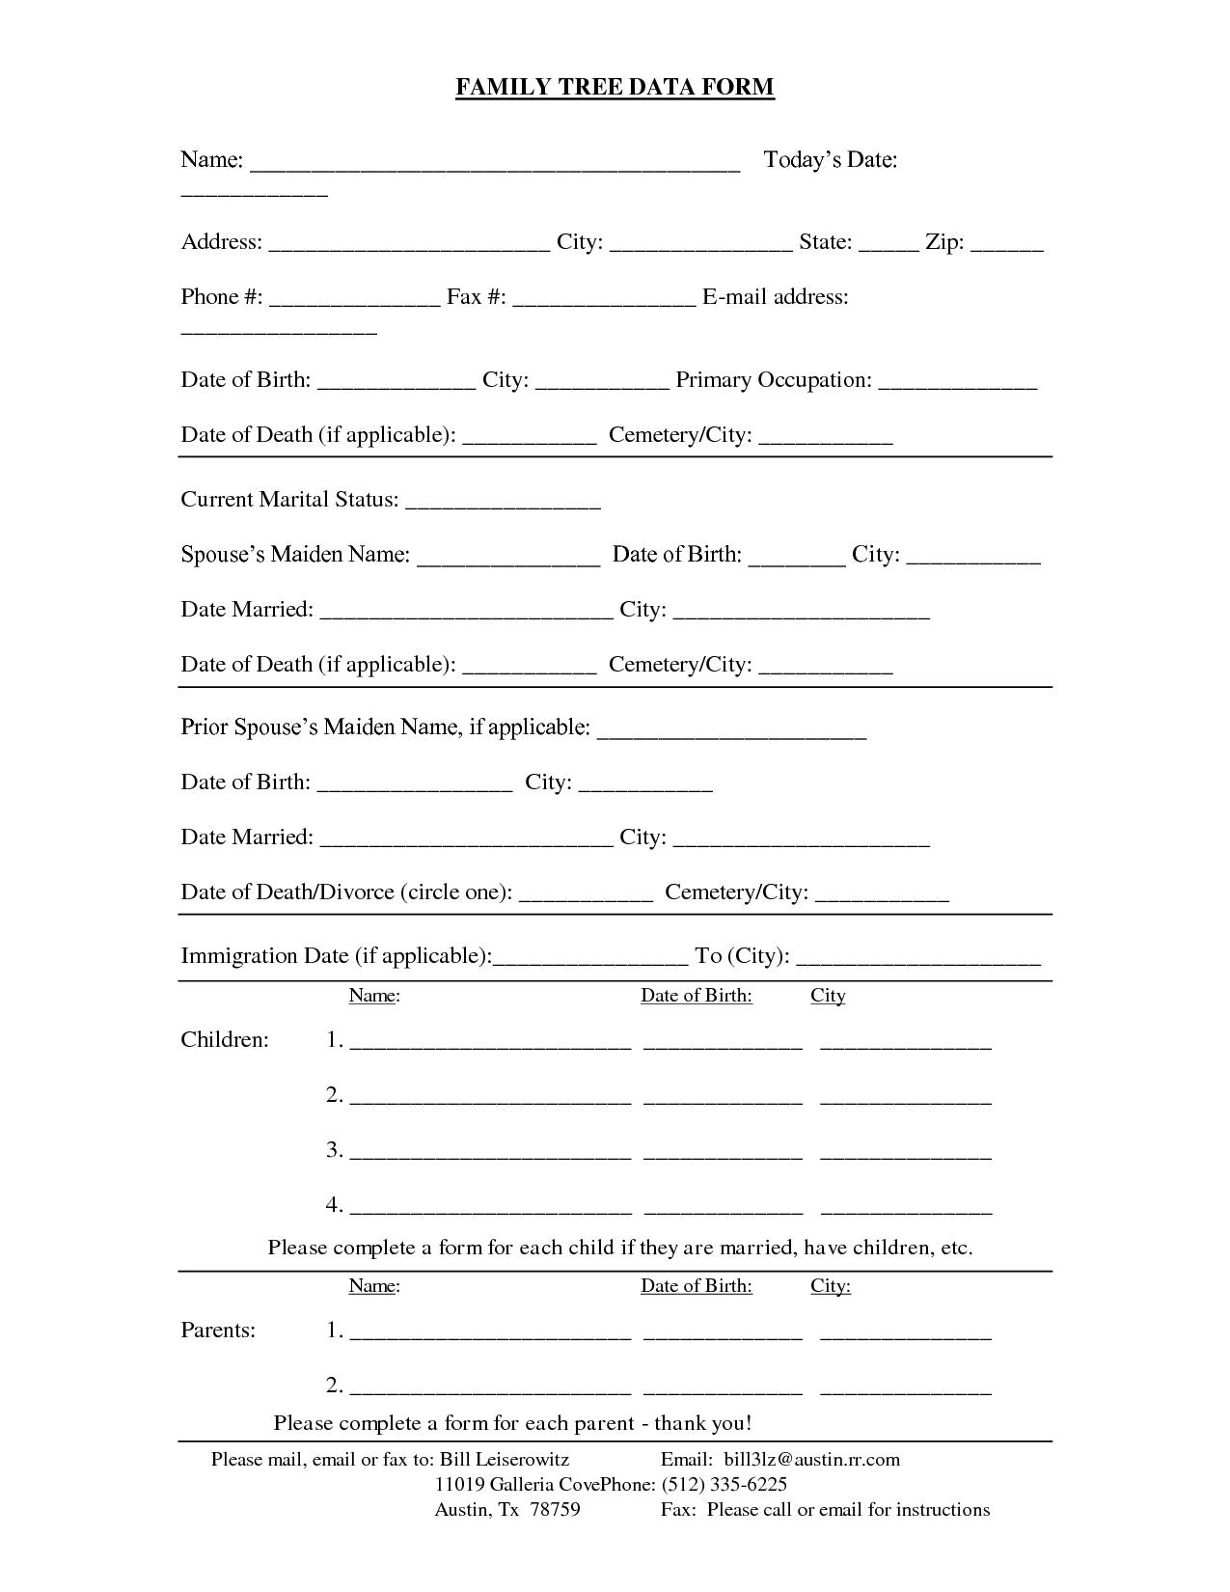
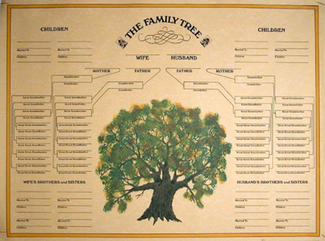
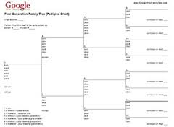
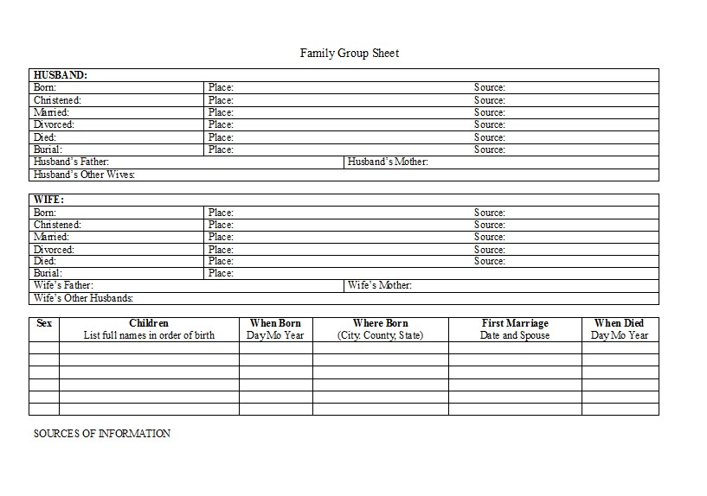
Read and Do Form-fill Type-in

Slide 6
Form-fill: Click-only

Slide 7
Synergistic: Automatic Form-fill with Human Confirmation/Correction
√
√
√
√

Slide 8
Demo
Annotator Framework
Session initialization/save/termination
Page mode/magnification/navigation
Form Fill-in
Person
Marriages
Children
Notes:
Use Ely for basic demo
Run through and show basics (all forms briefly)
Walk through the Steele page with them practicing at the same time
Let them ask questions or point out questions that should be asked
Show rules (which they’ll have available to them while they work)
Modify rules if new questions arise

Slide 9
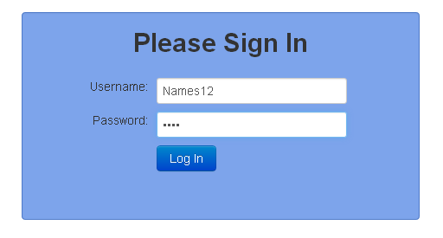
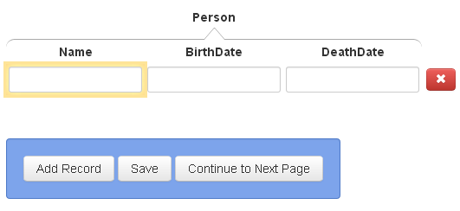
Session Initialization/Save/Termination
Navigate to “dithers.cs.byu.edu/bookannotator” and login:
You will be given several username-password pairs. Each is associated with an annotation job to do.
Select page to annotate:
Save / Continue to Next Page:
When you have finished all assigned pages and have saved your work, you need do nothing more. To start another job, navigate to “dithers.cs.byu.edu/fhannotator”

Slide 10
Page Mode/Magnification/Navigation
magnify: zoom in and out
go to previous page, next page
mode
bounding box
scroll bars
Notes:
Replace image when font-size issue is resolved. Also, there’s talk about a shaded bounding box around the text a click extracts.

Slide 11
Rules and Hints for All Forms
Rules
Record only typeset information (nothing written by hand).
Do not fix errors (OCR, typesetting, misspellings, …).
Restore “real” end-of-line hyphens.
For items that cross page boundaries, extract complete records with the first page. (If no previous/subsequent page, extract partial records.)
Use click, Alt-click, or mouse-drag-and-click only (to the extent possible).
Hints
For click and Alt-click, hold down Ctrl to add tokens to a field. (Sometimes a click doesn’t “take”; just click again.)
To remove a character that should be omitted, click on the character and use Backspace/Delete, and then Esc when done.
The field focus changes automatically; to change manually, use Tab and shift-Tab or click on a field and Esc.
A blank record or field at the end need not be deleted.
Be familiar with all Actions and use Keyboard Shortcuts.
Notes:
Put the real Keyboard Shortcuts in place of this old one.
Instead of Ctrl, use Command on a MAC.

Slide 12
Rules and Hints for All Forms
Rules
Record only typeset information (nothing written by hand).
Do not fix errors (OCR, typesetting, misspellings, …).
Restore “real” end-of-line hyphens.
For items that cross page boundaries, extract complete records with the first page. (If no previous/subsequent page, extract partial records.)
Use click, Alt-click, or mouse-drag-and-click only (to the extent possible).
Hints
For click and Alt-click, hold down Ctrl to add tokens to a field. (Sometimes a click doesn’t “take”; just click again.)
To remove a character that should be omitted, click on the character and use Backspace/Delete, and then Esc when done.
The field focus changes automatically; to change manually, use Tab and shift-Tab or click on a field and Esc.
A blank record or field at the end need not be deleted.
Be familiar with all Actions and use Keyboard Shortcuts.
Notes:
Put the real Keyboard Shortcuts in place of this old one.
Instead of Ctrl, use Command on a MAC.

Slide 13
Record only typeset information (nothing written by hand).
This, not that

Slide 14
Do not fix errors (OCR, typesetting, misspellings, …).

Slide 15
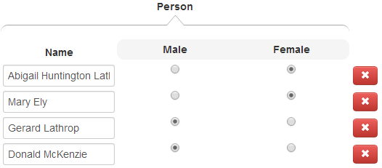
Restore “real” end-of-line hyphens.
Alt-click on “McKen-” properly extracts all of “McKenzie”.
Alt-click on “Latter-” in: “… Latter-
day Saints” also yields “Latterday”. Restore “real” hyphen: “Latter-day” (click on field and edit)

Slide 16
For items that cross page boundaries, extract complete record with the first page. (If no previous/subsequent page, extract partial records.)
page 1
page 2
record together with first page
(page 418)

Slide 17
Rules and Hints for Person Form
Rules
Extract every name on a page (except names that don’t designate people, e.g., “George Washington University”).
Extract non-names that designate a person not otherwise named (e.g., “Baby Ely”)
Get full name, including any punctuation, title(s) and suffix, but not non-name components associated with the name such as footnote references. Omit possessives (i.e., ’s).
Extract names as written. (Do not include implied maiden names and surnames).
Extract dates and place names only for birth and death events.
Get full date and place names, including punctuation.
In the absence of birth or death dates, use christening or burial dates and include designations (e.g., “bapt. 1854).
Hints
For names and dates with punctuation, use Alt-click.
Use Ctrl to append name parts.
Use Keyboard Shortcut “a” to add a record.
Notes:
If we do shift-click to include punctuation, change the hint to use it rather than mouse-drag-and-click. Say, “For names with punctuation, use shift-click or mouse-drag-and click.”

Slide 18
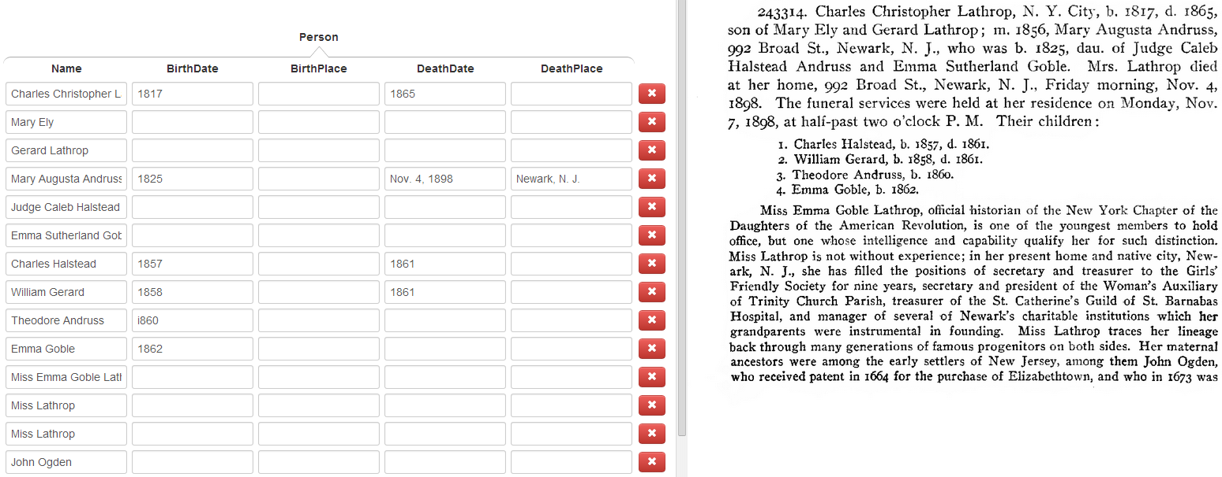
Extract all names, but dates and places only for birth and death events
this place but not these places
this date but
not this date
all names, even when a name appears more than once on a page

Slide 19
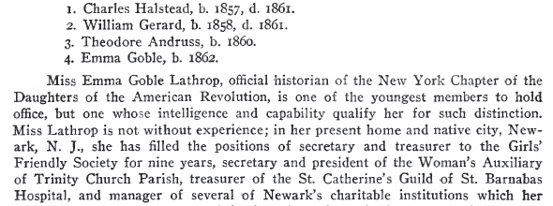
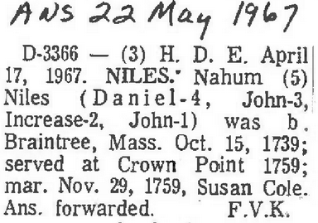
Extract every name on a page (non-person names). Omit non-name components.
not embedded reference markers
not names that are part of place or thing names
not paragraph headers
not names used for internal designators

Slide 20
Get full name, including any punctuation, title(s) and suffix. Omit possessives.
Isaac Steel, Sr.
Azubah Tully
Joel M. Gloyd
Chief Justice Waite
David Vance CALL
Rex – omit the surname, “Call” (not written with the name “Rex”)
Arta (Shippee) Call – include the parentheses
Jolayne Lois SILLITO

Slide 21
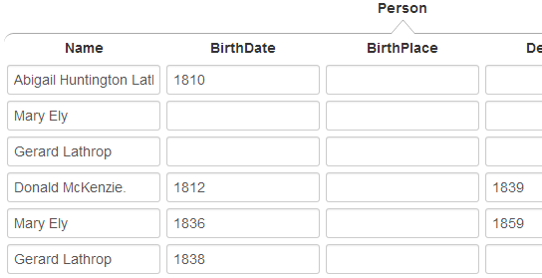
Do not include implied maiden names and surnames.
not “Mary Ely Lathrop”
not “Mary Ely McKenzie”
not “Gerard Lathrop McKenzie”
just the names as written

Slide 22
Get full date and place names, including punctuation.
include date modifiers
not date modifiers, not date explanations
(do not include)
days of the week (do not include)
punctuation part of date
(include)
punctuation not part of date (do not include)

Slide 23
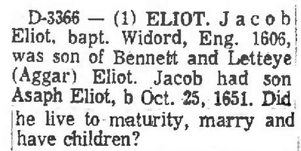
In the absence of birth or death dates, use christening or burial dates and include designations.

Slide 24
Rules and Hints for Marriages Form
Rules
Record all marriages, both stated and implied (e.g., if A is mentioned as the son of B and C, then record B and C as being married).
For persons with multiple marriages, record each marriage in a separate record.
Extract names as specified for the person form---full name including punctuation, but only the name as written, not including implied maiden and surnames.
Hints
Use Tab or “a” to add a new blank marriage record (when there is no MarriageDate).
“Spouse1” can be either the husband or the wife; record names in the order they appear in the document.
Notes:
Note: Tab is not yet implemented.

Slide 25
Record all marriages, both stated and implied.
stated
implied
names, as written (maiden name, married name not included)

Slide 26
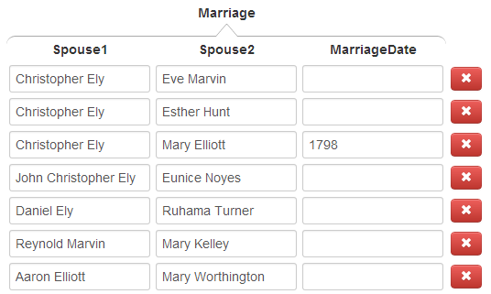
For persons with multiple marriages, record each marriage in a separate record.
Christopher with three marriages & three records

Slide 27
Rules and Hints for Children Forms
Rules
Sometimes the same surname appears for every child. Be sure to properly include each separate surname with each separate name.
Include families only if parents and at least one child appear in the given sequence of pages.
Record families that extend across page boundaries with the first page.
Hints
When the focus is on a list field, a number key, n, adds n more blank fields to the list. Count the number of children and add the right number of fields first, then fill them in (e.g., if there are 5 children, enter 4 to add 4 more fields for the children; for 24 children, enter 9, then 9 again, and finally 5).
Use “a” to add a new record if you wish to jump out of the middle of the record you’re working on and start a new record.

Slide 28
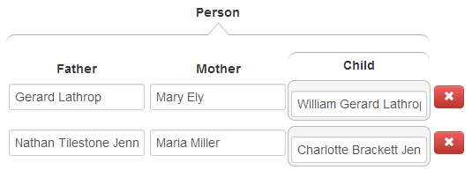
Don’t forget children, not explicitly marked as “children”.

Slide 29
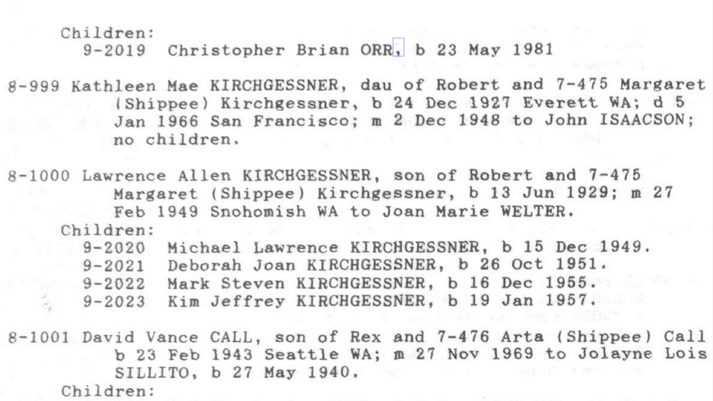
Be sure to properly include each separate surname with each separate name.
For “Michael Lawrence KIRCHGESSNER”, click here, here, and here.
For “Deborah Joan KIRCHGESSNER”, click here, here, and here.

Slide 30
Record children with families that extend across page boundaries with the first page.
omit, if first page; otherwise record with parents on previous page
no children,
omit
include
omit, if last page; otherwise record children with this page

Slide 31
Good Luck!
(our ancestors are waiting)

