Slide 1
Populating Ontologies by Semi-automatically Inducing Information Extraction Wrappers for Lists in OCRed Documents
Thomas L. Packer
12/2012 CS/BYU
Notes:
Read it

Slide 2
Research Area as a Prezi presentation: http://prezi.com/vg8dyhx11kq0/dissertation-proposal-list-reading/?kw=view-vg8dyhx11kq0&rc=ref-4464709
Notes:
Read it

Slide 3
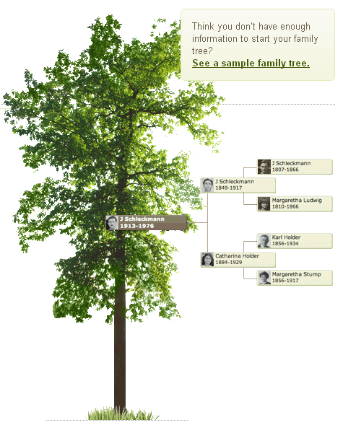
Family History
Motivation
Related Work
Project Description
Validation
Conclusion
Notes:
Dr. Liddle likes this slide.
Do you have enough information to start your family tree?

Slide 4
Anyone Like Family History?
10M people do it http://www.deseretnews.com/article/700180627/Genealogy-Expanding-the-family-tree.html?pg=all
$1B/year market http://blog.genlighten.com/2010/03/01/genealogy-a-1b-market-maybe/
2nd most popular hobby
Motivation
Related Work
Project Description
Validation
Conclusion
Notes:
Me: Worked at Ancestry.com for three years and talked with people from FamilyLink.com, FamilySearch.org, etc.
Market: behind gardening

Slide 5
What is Family History Research?
Search for ancestors in records
Construct family trees from records
Add to them:
Data
Photos
Stories
Temple work
Motivation
Related Work
Project Description
Validation
Conclusion
Notes:
Business: Give access to historical data, both hand-written and machine printed, construct trees, attach photos and stories, do and record temple work. There are few things more important than our connections to our fathers.

Slide 6
Willing to Work?
Annotate records
125,000 volunteers at FamilySearch.org
Family trees
26M at Ancestry.com
More at other sites
Motivation
Related Work
Project Description
Validation
Conclusion
Notes:
Are people willing to annotate lists to make them quariable?
Unpaid volunteers annotation whatever data FamilySearch makes available.
Easier to read, more volunteers, faster it gets done.
Are people willing to do work to create family trees?
They pay Ancestry.com to do so.

Slide 7
How Do we Do it?
Manual
Automation
OCR → keyword search only
Extract rich data → querying, record linkage, question answering
Motivation
Related Work
Project Description
Validation
Conclusion
Notes:
Companies use OCR and manual learn and data entry
Distinctions in data allow for more expressive queries
Automatic means record linkage, relies on rich data
Given name vs. surname – it’s implicit in the list structure

Slide 8
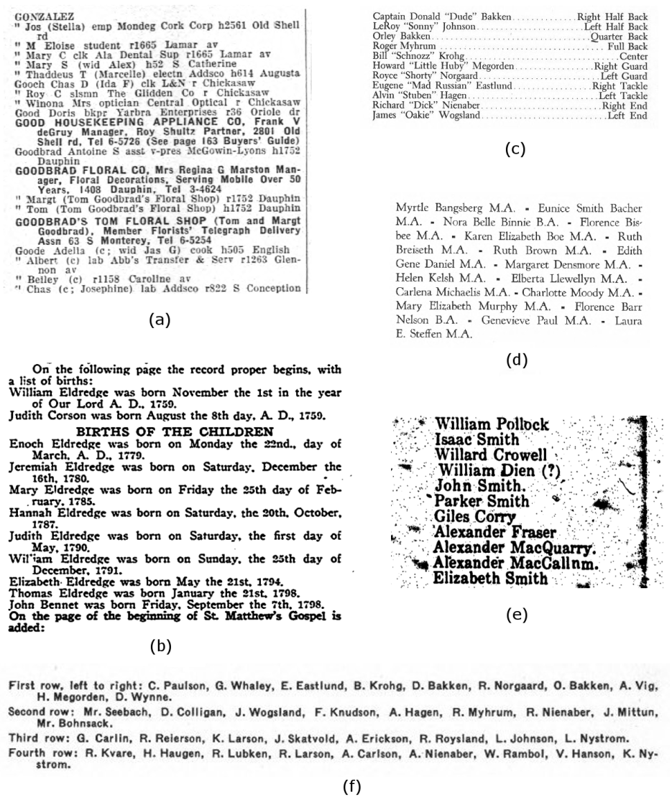
What Records?
Source records
Hand written
Machine printed
Lists
Rich and dense
Variable and underutilized
Documents
Family history books
City directories
Birth, marriage, death records
School yearbooks
Church yearbooks
Newspapers
Local history books
Navy cruise books
Motivation
Related Work
Project Description
Validation
Conclusion
Notes:
Value of printed text:
Ancestry paid us gift money twice
FamilySearch is working with us to annotate samples of their 50,000+ family history books
Lists:
Data is most densely concentrated in lists
Documents:
10 kinds, all contain lists, all unique in structure and content, some containing several kinds of lists, requiring wrapper induction.
Liddle likes the motivation on this slide.

Slide 9
What is a List?
Contiguous sequence of records
Records contain fields and delimiters in a regular language
Fields may be nested lists
Motivation
Related Work
Project Description
Validation
Conclusion
Notes:
Want to extract information, too hard so far.

Slide 10
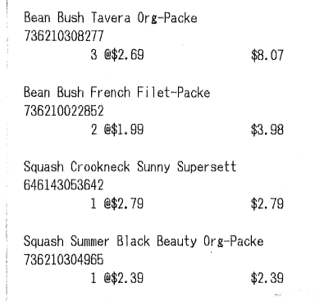
Other Applications?
Printed receipts
Nutrition app (Noshly.com)
Marketing + personal finance app (Itemize.com)
Document conversion
Citation metrics
Motivation
Related Work
Project Description
Validation
Conclusion
Notes:
Want to extract information, too hard so far.

Slide 11
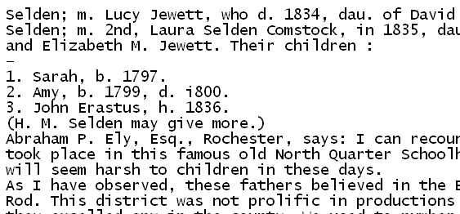
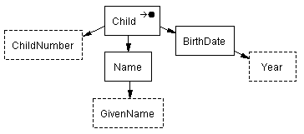
Research Project
Child(child₁)
Child-ChildNumber(child₁, “1”)
Child-Name(child₁, name₁)
Name-GivenName(name₁, “Sarah”)
Child-BirthDate(child₁, date₁)
BirthDate-Year(date₁, “1797”)
Motivation
Related Work
Project Description
Validation
Conclusion
Notes:
We have a list of the children of a person in a family history book.
We would like to extract the data from lists as predicates to enter into a user-specified ontology.
Reduce manual effort in that red arrow.

Slide 12
Wrapper Induction
Related Work: Wrapper Induction | Lists | OCR | OCR Error Tolerant | OCR & Lists | Ont. | Lists and Ont.
Sum | 7.7 | 2.0 | 0.5 | 1.8 | 3.0 | 2.2
blanco_redundancy_2010 | 0.5 | 0.0 | 0.0 | 0.0 | 0.5 | 0.3
dalvi_automatic_2010 | 0.5 | 0.0 | 0.0 | 0.0 | 0.0 | 0.0
gupta_answering_2009 | 1.0 | 0.0 | 0.0 | 0.0 | 0.5 | 0.5
carlson_bootstrapping_2008 | 0.0 | 0.0 | 0.0 | 0.0 | 0.0 | 0.0
heidorn_automatic_2008 | 0.8 | 1.0 | 0.5 | 0.8 | 0.5 | 0.4
chang_automatic_2003 | 0.5 | 0.0 | 0.0 | 0.0 | 0.0 | 0.0
crescenzi_roadrunner_2001 | 0.0 | 0.0 | 0.0 | 0.0 | 0.0 | 0.0
lerman_automatic_2001 | 0.8 | 0.0 | 0.0 | 0.0 | 0.0 | 0.0
chidlovskii_wrapper_2000 | 0.8 | 0.0 | 0.0 | 0.0 | 0.0 | 0.0
kushmerick_wrapper_2000 | 0.0 | 0.0 | 0.0 | 0.0 | 0.0 | 0.0
lerman_learning_2000 | 0.8 | 0.0 | 0.0 | 0.0 | 0.0 | 0.0
thomas_t-wrappers_1999 | 0.0 | 0.0 | 0.0 | 0.0 | 0.0 | 0.0
adelberg_nodose_1998 | 1.0 | 1.0 | 0.0 | 1.0 | 0.5 | 0.5
kushmerick_wrapper_1997 (dis.) | 0.5 | 0.0 | 0.0 | 0.0 | 0.5 | 0.3
kushmeric_wrapper_1997 (paper) | 0.5 | 0.0 | 0.0 | 0.0 | 0.5 | 0.3
Motivation
Related Work
Project Description
Validation
Conclusion
Notes:
Quickly. Don’t say so much.
Not much extract as much info as is found in lists.

Slide 13
Wrapper Induction for Printed Text
Adelberg 1998:
Grammar induction for any structured text
Not robust to OCR errors
No empirical evaluation
Heidorn 2008:
Wrapper induction for museum specimen labels
Not typical lists
Supervised—will not scale well
Entity attribute extraction–limited ontology population
Motivation
Related Work
Project Description
Validation
Conclusion

Slide 14
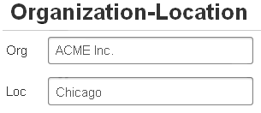
Typical Ontology Population
Motivation
Related Work
Project Description
Validation
Conclusion
Notes:
Most work extracts one or two kinds of facts:
Specialization (unary)
Properties (binary)
These do not represent the full range of expressiveness in lists data.

Slide 15
Expressive Ontology Population
Lexical vs. non-lexical
N-ary relationships
M degrees of separation
Functionality and optionality
Generalization-specialization class hierarchies
GivenName(“Joe”) vs. Person(p₁)
City-Population-Year(“Provo”, “115000”, “2011”)
Husband-Wife(p₁, p₂), Wife-BirthDate(p₂, d₂), BirthDate-Year(d₂, “1876”)
Person-Birth() vs. Person-Marriage()
Business vs. Person
Motivation
Related Work
Project Description
Validation
Conclusion
Notes:
Need this expressive information to perform querying of database, record linkage, question answering, better information retrieval.

Slide 16
Why not Apply Web Wrapper Induction to OCR Text?
Noise tolerance:
Allow character variations → increase recall → decrease precision
Populate only the simplest ontologies
Problems with wrapper language:
Left-right context (Kushmeric 2000)
Xpath (Dalvi 2009, etc.)
CRF (Gupta 2009)
Motivation
Related Work
Project Description
Validation
Conclusion
Notes:
We must come up with a new way to improve recall and keep precision up
HTML assumptions
Gupta’s web-scale assumptions

Slide 17
Solution: ListReader
OCR
Wrapper induction
Semi-supervised
Weakly Supervised
Bootstrapping
Extract information into ontology
Motivation
Related Work
Project Description
Validation
Conclusion
Notes:
Rely on OCR: take what we get in fields, error correction is a separate research area, we must be tolerant of errors to extract correct text.
Efficiently and accurately induce format-specific sequence labelers
Assigning the right labels to words in text means we can produce predicates with which to populate an ontology.
Our accurate sequence labeler will be formed efficiently using wrapper induction techniques. It will be accurate because it is specialized for each list format. It will be induced efficiently because it will take advantage of the patterns within and among lists.
Bootstrapping: automatic cyclical process in (2) that labels its own training data. Must start somewhere: (1).

Slide 18
Semi-supervised Wrapper Induction
Child(child₁)
Child-ChildNumber(child₁, “1”)
Child-Name(child₁, name₁)
Name-GivenName(name₁, “Sarah”)
Child-BirthDate(child₁, date₁)
BirthDate-Year(date₁, “1797”)
Motivation
Related Work
Project Description
Validation
Conclusion
Notes:
We have a list of children of a person in a family history book.
We would like a user-specified ontology and to extract data from lists as predicates to enter into that ontology.
Point out OCR errors
We wish to extract these facts from this list and insert them into this ontology.
To start with, we have no ontology and no way to know how facts are represented in this list.

Slide 19
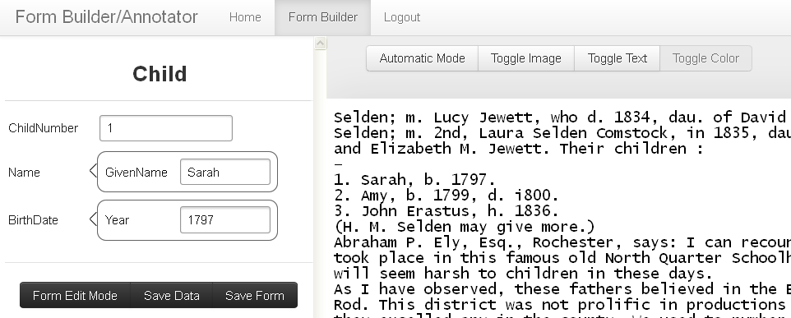
Construct Form, Label First Record
<Child.ChildNumber>1</Child.ChildNumber>. <Child.Name.GivenName>Sarah</Child.Name.GivenName>, b. <Child.BirthDate.Year>1797</Child.BirthDate.Year>.
Motivation
Related Work
Project Description
Validation
Conclusion
Notes:
User constructs an ontology by constructing a entry form.
User labels first record by inserting text into form.

Slide 20
Wrapper Generalization
1. Sarah, b. 1797.
2. Amy, h. 1799, d. i800.
3. John Erastus, b. 1836, d. 1876.
…
,
b
.
Child.BirthDate.Year
.
\n
…
,
b/h
.
Child.BirthDate.Year
?
?
?
?
.
\n
Motivation
Related Work
Project Description
Validation
Conclusion
Notes:
User constructs an ontology by constructing a entry form.
User labels first record by inserting text into form.
ListReader inserts OCR variants (matching whole records constrains and filters out bad wrappers, increases precision)
ListReader opts to insert a few words into the wrapper and request labels for them.

Slide 21
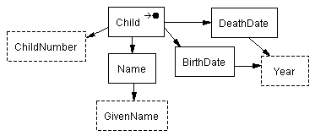
Wrapper Generalization
1. Sarah, b. 1797.
2. Amy, h. 1799, d. i800.
3. John Erastus, b. 1836, d. 1876.
…
,
b
.
Child.BirthDate.Year
.
\n
…
,
b/h
.
Child.BirthDate.Year
?
?
?
?
.
\n
…
,
b/h
.
Child.BirthDate.Year
,
d
.
Child.DeathDate.Year
.
\n
Motivation
Related Work
Project Description
Validation
Conclusion
Notes:
The user updates the form which adds another object set to the ontology.
The user labels the new field which then updates the wrapper and allows it to extract the second record.

Slide 22
Wrapper Generalization as Beam Search
Initialize wrapper from first record
Apply predefined set of wrapper adjustments
Score alternate wrappers with:
“Prior” (is like known list structure)
“Likelihood” (how well they match next text)
Add best to wrapper set
Repeat until end of list
Motivation
Related Work
Project Description
Validation
Conclusion
Notes:
Add word to field.
Remove word in field.
Add field.
Remove field.
Generalize character class of word.
Generalize length of word.

Slide 23
Mapping Sequential Labels to Predicates
\n
Child.ChildNumber
.
Child.Name.GivenName
,
b
.
Child.BirthDate.Year
.
\n
<Child.ChildNumber>1</Child.ChildNumber>. <Child.Name.GivenName>Sarah</Child.Name.GivenName>, b. <Child.BirthDate.Year>1797</Child.BirthDate.Year>.
Child(child₁)
Child-ChildNumber(child₁, “1”)
Child-Name(child₁, name₁)
Name-GivenName(name₁, “Sarah”)
Child-BirthDate(child₁, date₁)
BirthDate-Year(date₁, “1797”)
Motivation
Related Work
Project Description
Validation
Conclusion
Notes:
Labels unlike any I’ve seen before.
Sequential labels are like the lexical object sets.
But when we add death year, we add a new kind of year or keep it the same year. Ontologies allow us to say the new year is of the same type but has a different relationship to the child.
So we label with respect to ontology, using label paths to specify exactly the predicates to be extracted.

Slide 24
Weakly Supervised Wrapper Induction
Apply wrappers and ontologies
Spot list by repeated patterns
Find best ontology fragments for best-labeled record
Generalize wrapper
Both above and below
Active learning without human input
Motivation
Related Work
Project Description
Validation
Conclusion

Slide 25
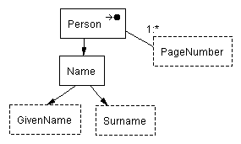
Knowledge from Previously Wrapped Lists
\n
Child.ChildNumber
.
Child.Name.GivenName
,
b
.
Child.BirthDate.Year
;
d
.
Child.DeathDate.Year
;
m
.
Child.Spouse.Name.GivenName
Child.Spouse.Name.Surname
.
\n
Motivation
Related Work
Project Description
Validation
Conclusion
Notes:
No form or input ontology.
John Erastus could have been ordered backward in the index and still work.
First part has newline, ChildNumber, period, Child GivenName.
Last part has m., Spouse GivenName, Spouse Surname.
Ontology from book name index has a person name containing John as GivenName and Erastus as Surname and relationships that link them togther.

Slide 26
List Spotting
\n
Child.ChildNumber
.
Child.Name.GivenName
.
\n
1. Sarah, b. 1797.
2. Amy, h. 1799, d. i800.
3. John Erastus, b. 1836.
\n
\n
\n
\n
\n
\n
Motivation
Related Work
Project Description
Validation
Conclusion
Notes:
The other records probably had labels too.
We clean them up by preserving only the ones with the most support from multiple recognizers and save them as the oracle—a fully automated oracle instead of a human oracle.

Slide 27
Select Ontology Fragments and Label the Starting Record
1. Sarah, b. 1797.
2. Amy, h. 1799, d. i800.
3. John Erastus, b. 1836.
\n
Child.ChildNumber
.
,
b
.
Child.BirthDate.Year
Motivation
Related Work
Project Description
Validation
Conclusion
Notes:
Identify the ontology fragments (not just the labels)

Slide 28
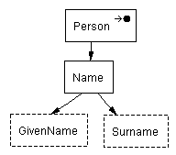
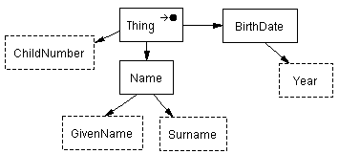
Merge Ontology and Wrapper Fragments
Motivation
Related Work
Project Description
Validation
Conclusion
Notes:
Identify the ontology fragments (not just the labels)

Slide 29
Generalize Wrapper, & Learn New Fields without User
d
.
Child.DeathDate.Year
.
1. Sarah, b. 1797.
2. Amy, h. 1799, d. i800.
3. John Erastus, b. 1836.
Motivation
Related Work
Project Description
Validation
Conclusion
Notes:
The other records had labels too.
If they had fields not in the initial record, use them like the oracle instead of the human user.
We clean them up by preserving only the ones with the most support from multiple recognizers and save them as the oracle—a fully automated oracle instead of a human oracle.

Slide 30
Thesis Statement
It is possible to populate an ontology semi-automatically, with better than state-of-the-art accuracy and cost, by inducing information extraction wrappers to extract the stated facts in the lists of an OCRed document, firstly relying only on a single user-provided field label for each field in each list, and secondly relying on less ongoing user involvement by leveraging the wrappers induced and facts extracted previously from other lists.
Motivation
Related Work
Project Description
Validation
Conclusion

Slide 31
Four Hypotheses
Is a single labeling of each field sufficient?
Is fully automatic induction possible?
Does ListReader perform increasingly better?
Are induced wrappers better than the best?
Motivation
Related Work
Project Description
Validation
Conclusion

Slide 32
Hypothesis 1
Single user labeling of each field per list
Evaluate detecting new optional fields
Evaluate semi-supervised wrapper induction
Motivation
Related Work
Project Description
Validation
Conclusion

Slide 33
Hypothesis 2
No user input required with imperfect recognizers
Find required level of noisy recognizer P & R
Motivation
Related Work
Project Description
Validation
Conclusion

Slide 34
Hypothesis 3
Increasing repository knowledge decreases the cost
Show repository can produce P- and R-level recognizers
Evaluate number of user-provided labels over time
Motivation
Related Work
Project Description
Validation
Conclusion
Notes:
Bootstrapping
A wrapper fragment or ontology fragment with n fields selected as a match of one or more record fragments of a list reduces the number of user-specified labels needed to extract all stated facts from L by n.
Show that bootstrapping beginning with Scenario 1 can produce P- and R-level noisy recognizers.
Determine how much user-specified labeling decreases in Scenario 2 using noisy recognizers induced in the bootstrapping process.
Call it tranfser learning

Slide 35
Hypothesis 4
ListReader performs better than a representative state-of-the-art information extraction system
Compare ListReader with the supervised CRF in Mallet
Motivation
Related Work
Project Description
Validation
Conclusion
Notes:
Comparison

Slide 36
Evaluation Metrics
Precision
Recall
F-measure
Accuracy
Number of user-provided labels
Motivation
Related Work
Project Description
Validation
Conclusion
Notes:
Precision: proportion of extracted fields that are correctly labeled.
Recall: proportion of true fields that were extracted.
F-measure: harmonic mean of precision and recall.
Accuracy: Proportion of words with correct field labels.
Number of user-provided labels: Number of labels provided to train wrapper induction and correct false extractions. Combines training cost and execution accuracy in one metric.

Slide 37
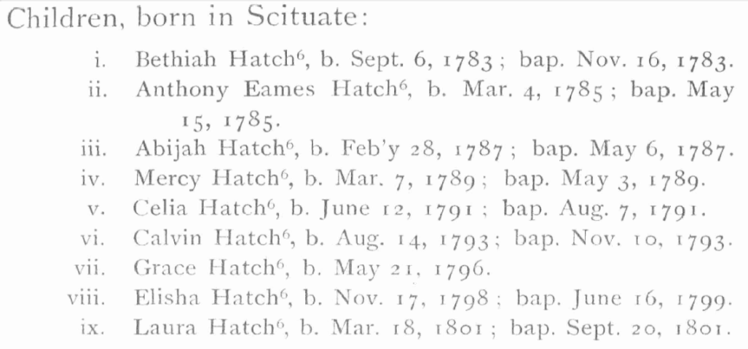
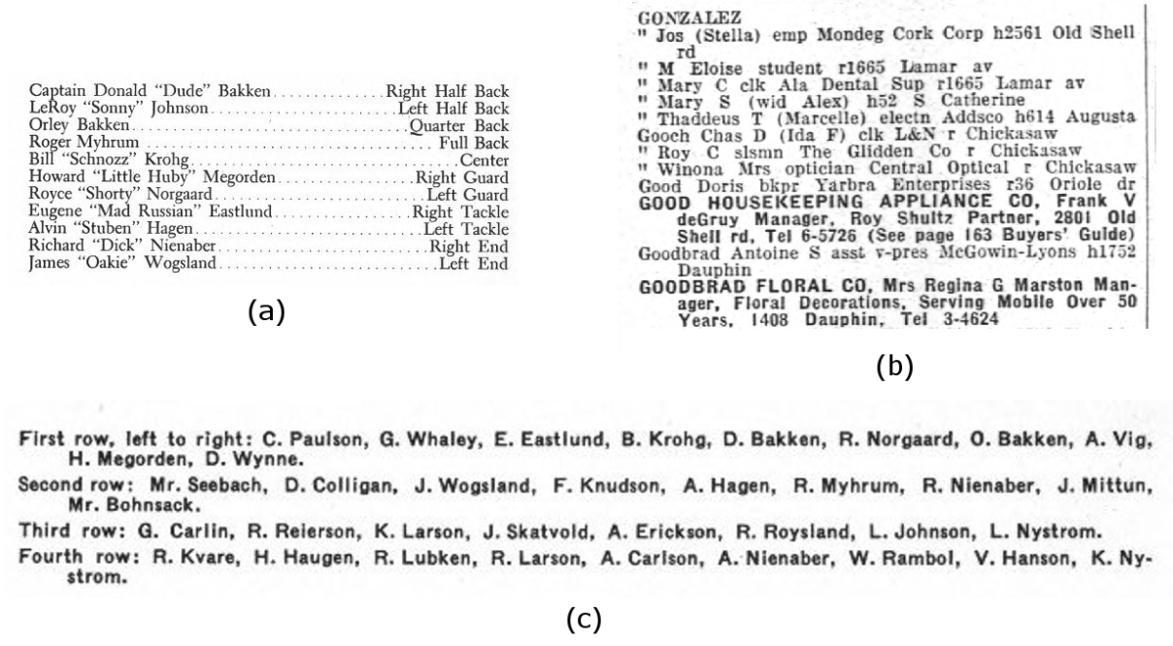
Corpus
Lists in several types of historical docs
Dev. set: ~100 pages
Blind set: ~400 pages
Motivation
Related Work
Project Description
Validation
Conclusion
Notes:
Compute statistically significant

Slide 38
Research Schedule
Prepare datasets --------------------------------------------------------------------------------------- Incremental
Semi-supervision and label mapping ------------------------------------------------------------------ Fall 2012
ICDAR conference paper “Semi-supervised Wrapper Induction for OCRed Lists” ------- Feb. 1 2013
Journal paper “Semi-supervised Wrapper Induction for OCRed Lists” -------------------- Winter 2013
Weak supervision -------------------------------------------------------------------------------------- Winter 2013
Journal paper “Weakly-supervised Wrapper Induction for OCRed Lists” ----------------- Winter 2013
Dissertation -------------------------------------------------------------------------------------------- Summer 2013
Dissertation defense --------------------------------------------------------------------------------------- Fall 2013
(Journals considered: IJDAR first; JASIST, PAMI, PR, TKDE, DKE second)
Motivation
Related Work
Project Description
Validation
Conclusion

Slide 39
Work and Results Thus Far
Large, diverse corpus of OCRed documents
Semi-supervised regex and HMM induction
Both beat CRF trained on three times the data
Designed label to predicate mapping
Implemented preliminary mapping
85% accuracy of word-level list spotting
Motivation
Related Work
Project Description
Validation
Conclusion
Notes:
Collected large and diverse corpus of OCRed documents and images in family history domain from Ancestry and FamilySearch
Initial semi-supervised regex induction, including:
Field insertion, field deletion, field lengthening, field shortening, word length and character set generalization, new field spotting, and end-of-list finding, all using text matching to select among transformations
Initial semi-supervised HMM induction (outperforms regex)
Worked out the mapping between labels and ontology schema elements and predicates on paper for our target schema elements
Translation of flat labels to OSMX ontology schema and facts (using early version of labels)
That is, my early semi-supervised wrapper induction beats a state-of-the-art supervised model that was given three times as much training data.
Label selection and list spotting based on noisy labels from dictionaries works at 85% accuracy on word-level granularity
Accuracy should be higher for finding any one record rather than every word.

Slide 40
Expected Contributions
ListReader
Wrapper induction
OCRed lists
Population ontologies
Accuracy and cost
Motivation
Related Work
Project Description
Validation
Conclusion

Slide 41
Questions & Answers

Slide 42
What Does that Mean?
Populating Ontologies
A machine-readable and mathematically specified conceptualization of a collection of facts
Semi-automatically Inducing
Pushing more work to the machine
Information Extraction Wrappers
Specialized processes exposing data in documents
Lists in OCRed Documents
Data-rich with variable format and noisy content
Motivation
Related Work
Project Description
Validation
Conclusion

Slide 43
Who Cares?
Populating Ontologies
Versatile, expressive, structured, digital information is queryable, linkable, editable.
Semi-automatically Inducing
Lowers cost of data
Information Extraction Wrappers
Accurate by specializing for each document format
Lists in OCRed Documents
Lots of data useful for family history, marketing, personal finance, etc. but challenging to extract
Motivation
Related Work
Project Description
Validation
Conclusion

Slide 44
Related Work
Current Research Problem
Wrappers
Machine Learning
Document Image Analysis
Information Extraction
Conceptual Modeling
Natural Language Processing
Artificial Intelligence
Motivation
Related Work
Project Description
Validation
Conclusion
Notes:
AI: Intelligent information processes
NLP: Processing of human language
IE: Pulling structured information out of unstructured documents
W: IE models specialized for each information source
ML: gives us the induction in wrapper induction
DIA: gives us OCR from document images as our input text
CM: gives us a more expressive target schema for extracted information

Slide 45
Related Work
Lists
Ontology Population
Noisy OCR Text
Wrapper Induction
Motivation
Related Work
Project Description
Validation
Conclusion
Notes:
No Lists + Ontology
No Wrapper + Ontology
2? List + OCR
6 Wrapper + List

Slide 46
List Reading
Specialized for one kind of list:
Printed ToC: Marinai 2010, Dejean 2009, Lin 2006
Printed bibs: Besagni 2004, Besagni 2003, Belaid 2001
HTML lists: Elmeleegy 2009, Gupta 2009, Tao 2009, Embley 2000, Embley 1999
Use specialized hand-crafted knowledge
Rely on clean input text containing useful HTML structure or tags
NER or flat attribute extraction–limited ontology population
Omit one or more reading steps
Motivation
Related Work
Project Description
Validation
Conclusion
Notes:
Long tail of list formats, the uncommon ones.

Slide 47
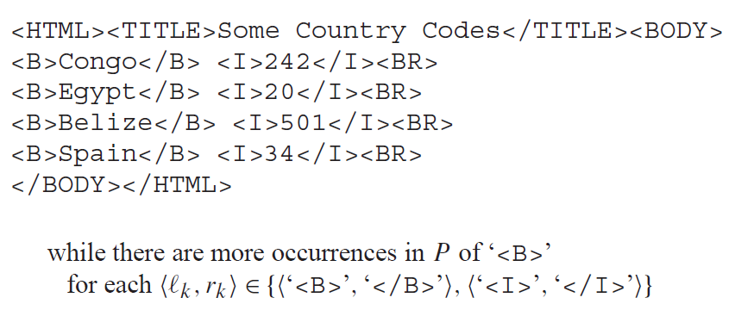
Why not Use Left-Right Context?
Field boundaries
Field position and character content
Record boundaries
OCRed List:
Motivation
Related Work
Project Description
Validation
Conclusion
Notes:
Often no unique delimiters in OCR: must look for combination of position of field among all the other fields and character content of field.
Before that, we need to delimit records.

Slide 48
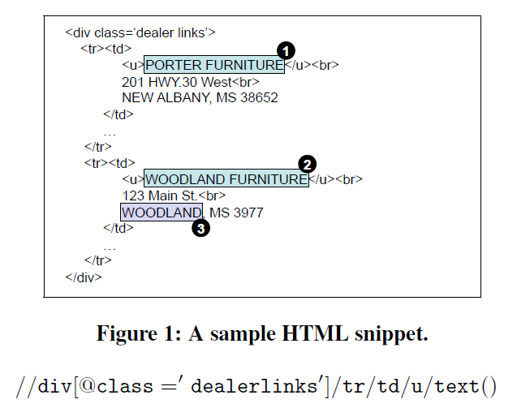
Why not Use XPaths?
OCR text has no explicit XML DOM tree structure
Xpaths require HTML tag to perfectly mark field text
Motivation
Related Work
Project Description
Validation
Conclusion

Slide 49
Why not Use (Gupta’s) CRFs?
HTML lists and records are explicitly marked
Different application: Augment tables using tuples from any lists on web
At web scale, they can throw away harder-to-process lists
They rely on more training data than we will
We will compare our approach to CRFs
Motivation
Related Work
Project Description
Validation
Conclusion

Slide 50
Page Grammars
Conway [1993]
2-D CFG and chart parser for page layout recognition from document images
Can assign logical labels to blocks of text
Manually constructed grammars
Rely on spatial features
Motivation
Related Work
Project Description
Validation
Conclusion

Slide 51
Reading Steps
List spotting
Record segmentation
Field segmentation
Field labeling
Nested list recognition
Members of the football team:
Captain: Donald Bakken.................Right Half Back
LeRoy "sonny' Johnson.........,........Lcft Half Back
Orley "Dude" Bakken......,.......,......Quarter Back
Roger Jay Myhrum........................ .Full Back
Bill "Snoz" Krohg,...........................Center
They had a good year.
Motivation
Related Work
Project Description
Validation
Conclusion

Slide 52
Special Labels Resolve Ambiguity
Child(child₁)
Child-ChildNumber(child₁, “1”)
Child-Name(child₁, name₁)
Name-GivenName(name₁, “Sarah”)
Child-BirthDate(child₁, date₁)
BirthDate-Year(date₁, “1797”)
1. Sarah, b. 1797.
2. Amy, h. 1799, d. i800.
3. John Erastus, b. 1836, d. 1876.
\n
Child.ChildNumber
.
Child.Name.GivenName
,
b
.
Child.BirthDate.Year
.
\n
<Child.ChildNumber>1</Child.ChildNumber>. <Child.Name.GivenName>Sarah</Child.Name.GivenName>, b. <Child.BirthDate.Year>1797</Child.BirthDate.Year>.
Motivation
Related Work
Project Description
Validation
Conclusion
Notes:
So we label with respect to ontology, using label paths to specify exactly the predicates to be extracted.
Page 141 Ely Ancestry

Slide 53
Agenda (90 minutes)
Research Area + Questions (35 minutes)
Research Problem + Questions (55 minutes)
Committee Deliberation ()
Please ask questions along the way

Slide 54
Research Area
35 minutes
Notes:
25 minutes for the presentation
10 minutes for questions
Point out: OCRed text and lists as input, wrapper induction as modeling, ontology population as output

Slide 55
Research Problem
55 minutes
Motivation
Related Work
Project Description
Validation
Conclusion
Notes:
35 minutes for the presentation
20 minutes for questions

